Slide 1

DATA ANALYSIS COMPANY IN WASHINGTON

Slide 2
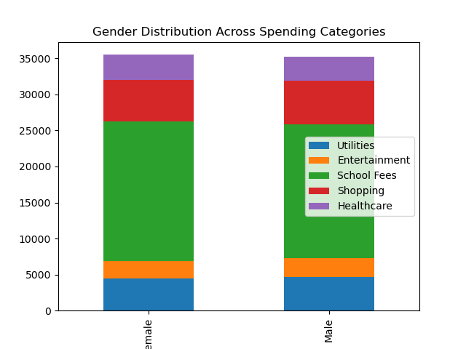
Gender distribution across spending categories

Slide 3
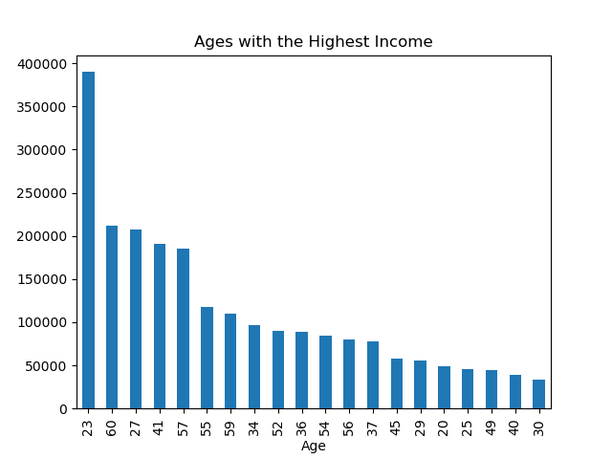
aGes with highest income

